Slide 1
Exercise 7: Organization of semantic memory
Cognition & Communication, Instructor: Adam Finnemann

Slide 2
Today’s Program:
Evaluation
?? Structure of semantic knowledge ??
Semantic memory experiment
Analysis
Discussion

Slide 3
Evaluation
What are your thoughts on the seminars?
Style of programming parts:
Everything individual ?
10 min individual, 10 min together ?
Everything together ?

Slide 4

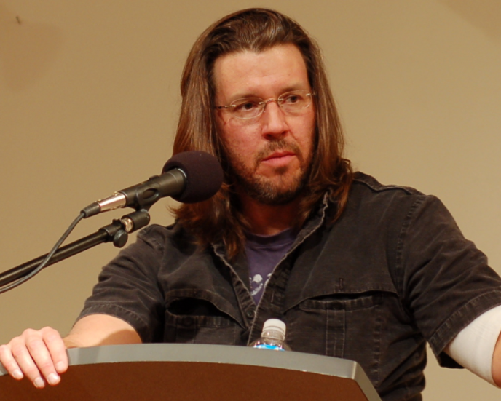
Catching up on our narrative
What the hell
Is water?
Remember the story about the little and big fish.
Today’s idea: It makes sense to talk about a structure of knowledge about language
Training our methods for doing so

Slide 5
Methods covered
Observational studies using annotation tools
Math-teacher exercise
Ape/Child child-parent interaction
Database analysis:
Child MLU from Childes
Experimental studies
Tangram
Russian Blue experiment
Computer based analysis
Today: Mixing database quieries and experiment
To come: computer based text analysis

Slide 6
What is a theory of meaning?
Early cog sci – builds on a philosophical logistic view on language :
- Logic describes the structure of sentences.
- A theory of meaning describes the content of our sentences.
Example: Sentences contain propositions that refer to objects/properties
Knowing the concept “game” is to know the definition of “game”.
- chess
- football
- ring-a-ring-a-rosie
So the word is vague and we don’t understand it?
Other possibility:
“where there is sense there must be perfect order. So there must be perfect order even in the vaguest sentence.”
(Wittgenstein, PU §98)

Slide 7
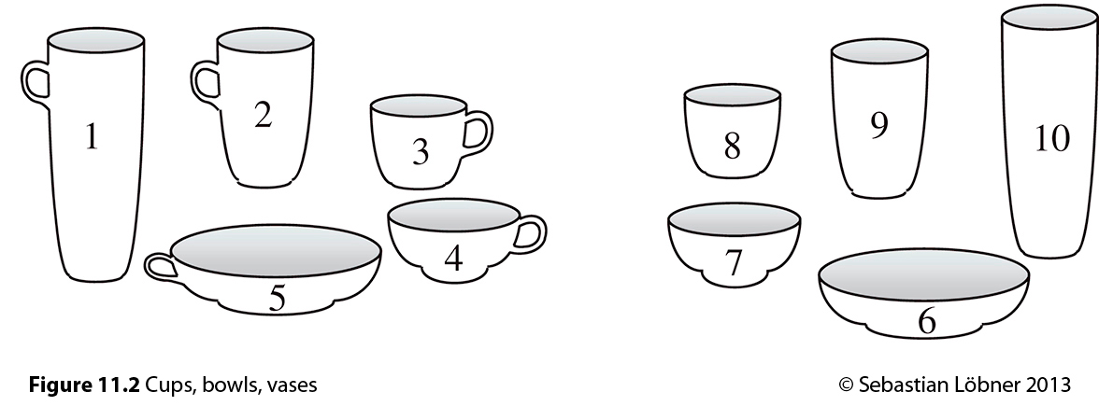
Wittgenstein’s challenge: You can have structure and vagueness.
Prototype theory allows for structure + vagueness

Slide 8
Prototype theory:
Knowing the concept ”game” is knowing the prototype of a ”game”.
We can predict lingustic behavior well by talking about distances between concepts
Implies there is a structure to our semantic knowledge
Which concept is closest to ”game”?
Chess
Football
Ring-a-ring-a-rosie

Slide 9
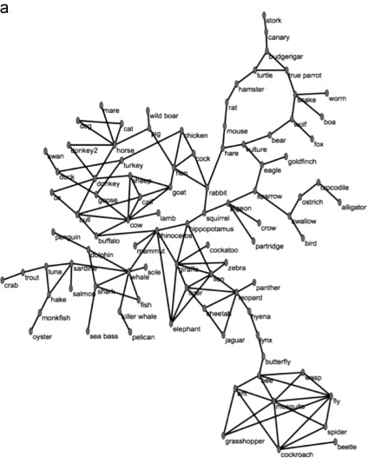
Semantic distances
We can represent semantic distances between multiple words to form a semantic network.
What predictions about association can we infer from this theory?

Slide 10
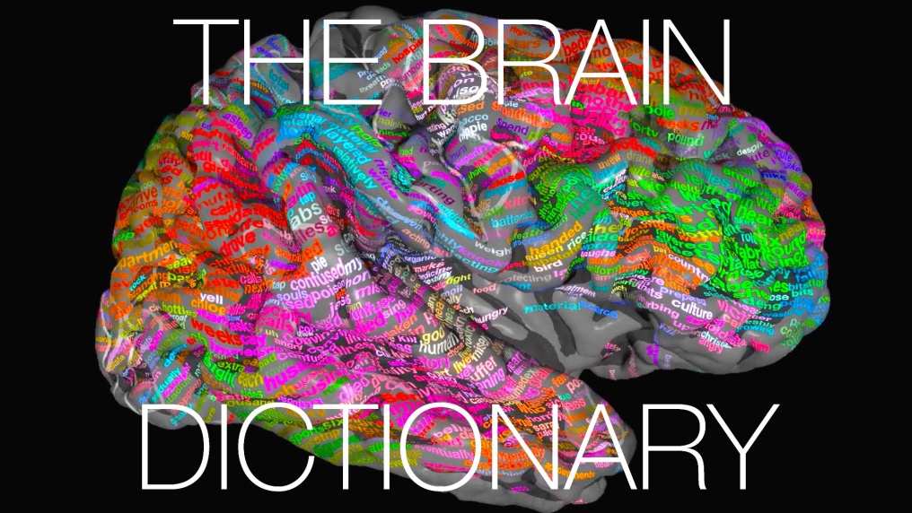
Neural semantic map
Conceptual knowledge seems distributed across the brain
Function/meaning overlap in brain: Behavior related words activate motor areas (Hauk, 2004)
A complete semantic map of the brain was published in Nature 2016 (Huth, 2016).
Mikkel’s home turf, Ask him for criticism of the result/method/theory.
Mikkel got nothing on their visualization though: http://gallantlab.org/huth2016/

Slide 11
Today’s exercise: Free association task
Download from bb: ‘semantics.py’
Work in pairs:
1 comes up with new words
1 writes in psychopy
Choose a topic
Animals
Food
Only in English; pay attention to correct >spelling<!

Slide 12
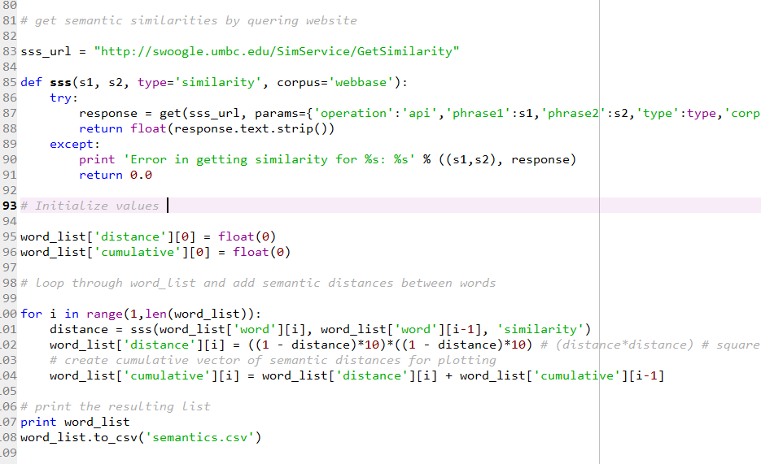
Semantic distance?
Function that
Takes 2 words as inputs
Plugs them into this webpage
And returns the result of the query

Slide 13
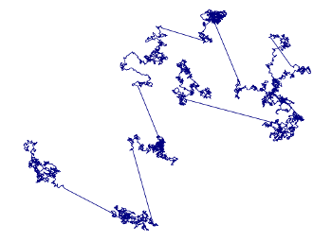
How do we search for words?
Theory: Like we forage for food
Levy flight: a particular complex pattern e.g. in the way animals search for food (Reynolds and Rhodes 2009)

Slide 14
Hypotheses
H1: We expect a high proportion of small ”jumps” in semantic distance and fewer large jumps.
H2: We expect a positive correlation between length of semantic distance and search time.

Slide 15
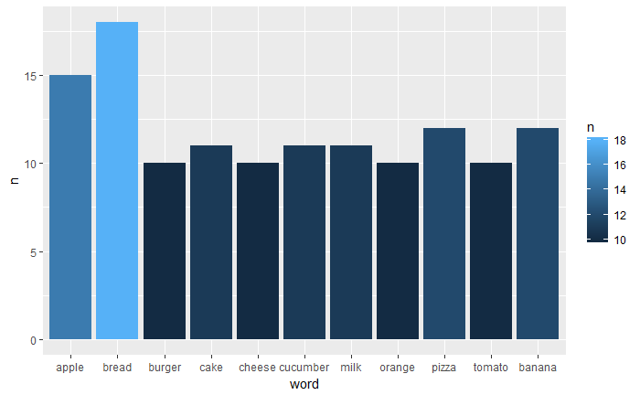
Results:
Most frequently used food words

Slide 16
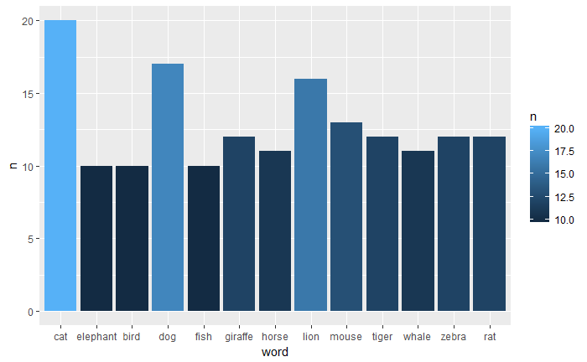
Results:
Most frequently used animal words

Slide 17
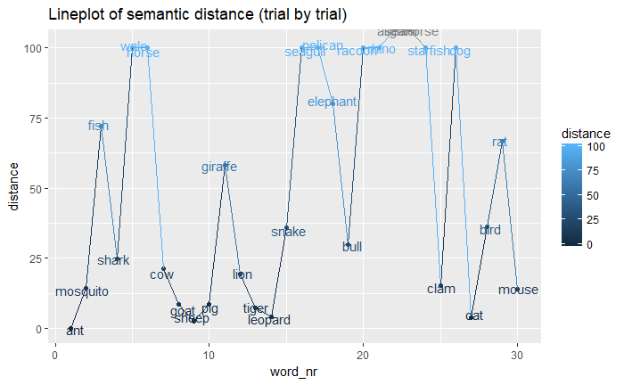
Result

Slide 18
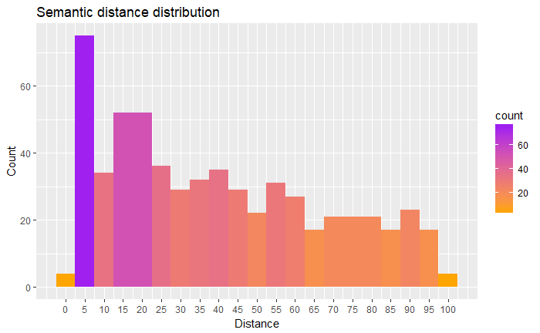
Results

Slide 19
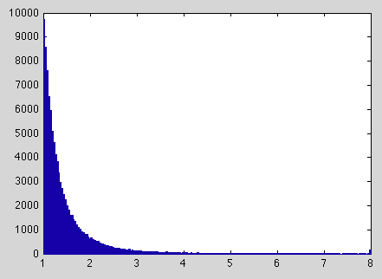
Discussion
Can we confirm H1?
Is semantic distances between words long-tailed distributed (power-law distributed):

Slide 20
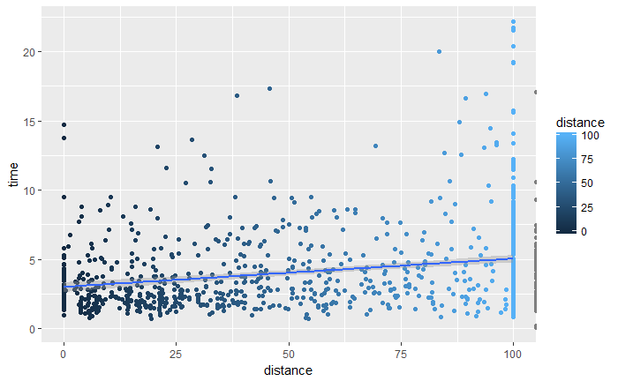
Semantic distance and search time

Slide 21
Discussion
Can we confirm H2?
Is there a a positvie correlation between semantic distance between words and search time?
Do we employ the same cognitive strategy in semantic search as foragers?

Slide 22
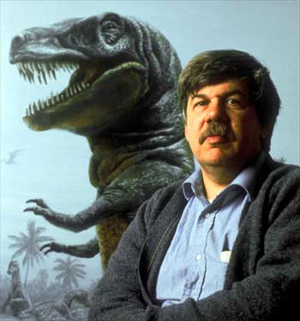

Stephen Jay Gould’s example
Initial shock and despair
Looked at distributions
Judged that he had a good chance of living for much more than 8 month
How did he make this judgement?

Slide 23
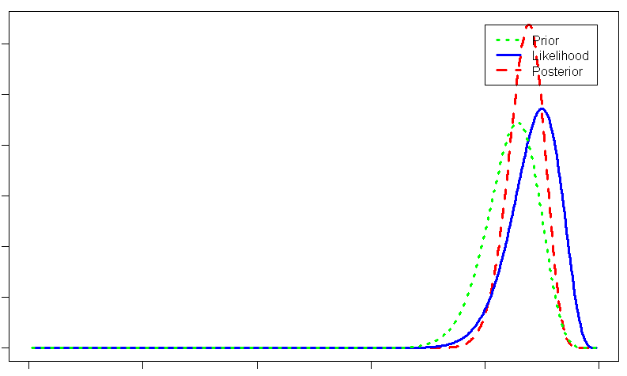
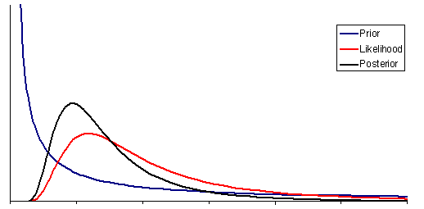
Importance of distrbutions for judgements!:
Thanks to Josh for slides explaning
Important point in an awesome way!

Slide 24
Preparing for next time
We will talk about probabilistic models.
Be comfortable with the word ”distrbution” i.e. be able to understand the difference between a power-law and normal distribution
Think about what it means that something has a high vs. low probability (I do this by thinking about drawing from urns).

